Slide 1
GROUP 5
COMPUTER GRAPHICS
1. Mark Horris Maina SCT211-0704/2022
2. George Githigi Ngugi SCT211-0460/2022
3. Sajjad Abdirahim Gedow SCT211-0065/2022
4. Emmanuel Yator SCT211-0622/2022

Slide 2
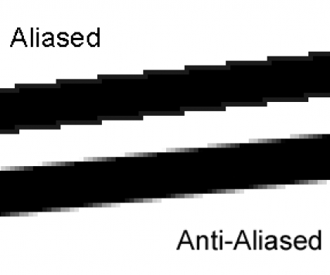
LINE RASTERIZATION AND ANTI-ALIASING
Line rasterization is the process of converting a continuous line defined by mathematical equations into discrete pixels on a screen. It decides which pixels best approximate a straight line between two points.
Anti-aliasing is a technique used to reduce jagged edges (aliasing) in rasterized images, especially for lines that are not perfectly horizontal or vertical.
It smooths the transition between pixel colors to better represent real-world visuals.

Slide 3
GUPTA-SPROULL ALGORITHM
Using OpenGL, write a program that draws a line using Gupta-Sproull algorithm line drawing algorithm: The parameters for the line are as follows –the starting point (20, 10) and ending coordinates (30, 18).
Builds on Bresenham’s algorithm to select primary pixels.
Anti-aliases by calculating perpendicular distance (D) and adjusting intensities of three pixels (y-1, y, y+1) using a criteria
Initial Decision Parameter (P_k):
Pk= 2 Δy -Δx
Case-01 (If Pk < 0):
P(k+1) = Pk+ 2ΔY
x(k+1) = xk+ 1
D(k+1)=Dk+sinθ
y(k+1) = yk
Case-02 (If Pk ≥ 0):
P(k+1)= Pk+ 2ΔY - 2ΔX
x(k+1)= xk+ 1
D(k+1)=Dk+sinθ-cosθ
y(k+1)= yk+ 1

Slide 4





STEP 1
Question 1
dx = x1 - x0
dy = y1 - y0
steep = abs(dy) > abs(dx)
if steep:
x0, y0 = y0, x0
x1, y1 = y1, x0
dx, dy = dy, dx
if x0 > x1:
x0, x1 = x1, x0
y0, y1 = y1, y0
dx, dy = dx, dy
x = x0
y = y0
d = 2 * dy - dx # Bresenham’s Pk
length = math.sqrt(dx * dx + dy * dy)
sin_theta = dx / length
cos_theta = dy / length
D = 0.0 # Perpendicular distance
Initial Decision Parameter :
Initial Distance Dk: = 0

Slide 5










STEP 2
while x <= x1:
plot_x = y if steep else x
plot_y = x if steep else y
pixels.append((plot_x, plot_y, 1.0)) # Primary pixel
# Anti-aliasing for three pixels
for offset in [-1, 0, 1]:
distance = D + offset * cos_theta
intensity = filter(abs(distance))
if intensity > 0.0:
yp = plot_y + offset
pixels.append((plot_x, yp, intensity))
x += 1
if d <= 0:
D += sin_theta
d += 2 * dy
else:
y += 1
D += sin_theta - cos_theta
d += 2 * (dy - dx)

Slide 6
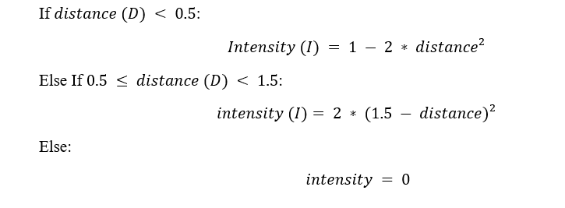
Anti-Aliased Distance & Intensity Calculation
def filter(distance):
if distance < 0.5:
return 1.0 - 2.0 * distance * distance
if distance < 1.5:
return 2.0 * (1.5 - distance) * (1.5 - distance)
return 0.0

Slide 7
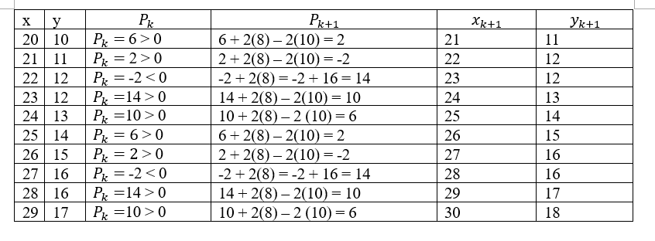

Slide 8
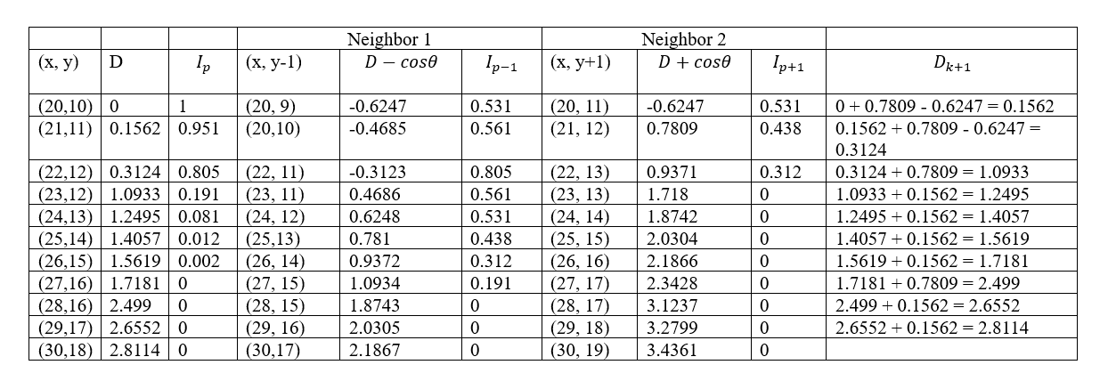

Slide 9
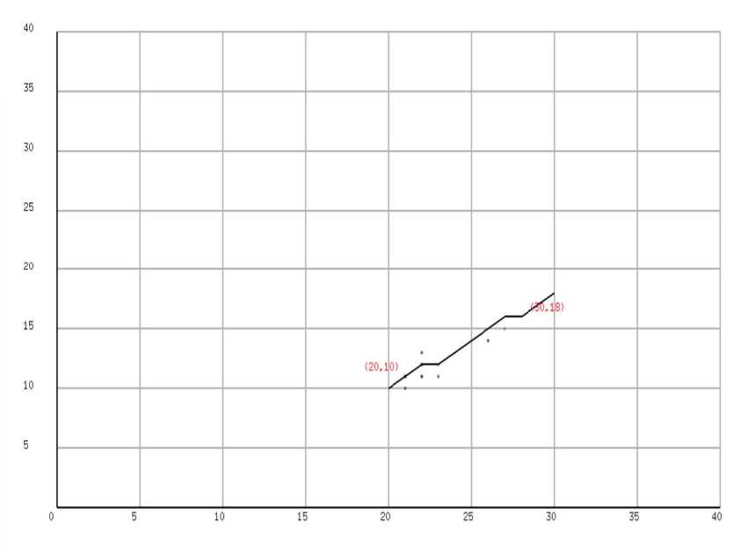

Slide 10
Xiaolin Wu's line algorithm
Directly calculates y-positions for each x using the gradient.
Distributes intensity between two pixels (⌊y⌋, ⌊y⌋ + 1) per step.
Special handling for endpoints with xgap.
Using OpenGL, write a program that draws a line using Xiaolin Wu's line algorithm line drawing algorithm:
The parameters for the line are as follows –the starting point (15, 10) and ending coordinates (23, 18).

Slide 11
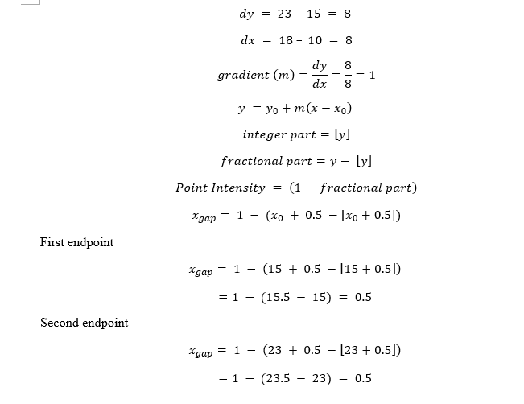
steep = abs(y1 - y0) > abs(x1 - x0)
if steep:
x0, y0 = y0, x0
x1, y1 = y1, x0
if x0 > x1:
x0, x1 = x1, x0
y0, y1 = y1, y0
dx = x1 - x0
dy = y1 - y0
gradient = 1.0 if dx == 0 else float(dy) / dx
xend = round(x0)
yend = y0 + gradient * (xend - x0)
xgap = 1.0 - (x0 + 0.5 - math.floor(x0 + 0.5))
xpxl1 = int(xend) ypxl1 = int(math.floor(yend))
yfrac1 = yend - ypxl1
if steep:
pixels.append((ypxl1, xpxl1, (1.0 - yfrac1) * xgap))
pixels.append((ypxl1 + 1, xpxl1, yfrac1 * xgap))
else:
pixels.append((xpxl1, ypxl1, (1.0 - yfrac1) * xgap))
pixels.append((xpxl1, ypxl1 + 1, yfrac1 * xgap))
intery = yend + gradient
for x in range(xpxl1 + 1, xpxl2):
y_floor = int(math.floor(intery))
y_frac = intery - y_floor
if steep:
pixels.append((y_floor, x, 1.0 - y_frac))
pixels.append((y_floor + 1, x, y_frac))
else:
pixels.append((x, y_floor, 1.0 - y_frac))
pixels.append((x, y_floor + 1, y_frac))
intery += gradient

Slide 12
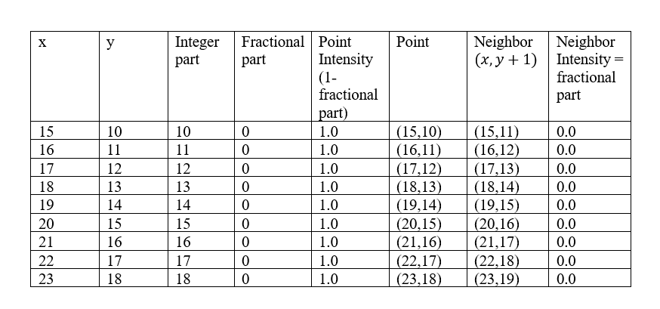

Slide 13
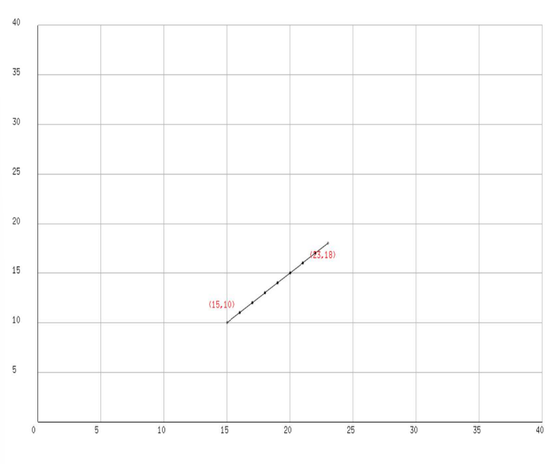

Slide 14
THANK YOU

